Slide 1
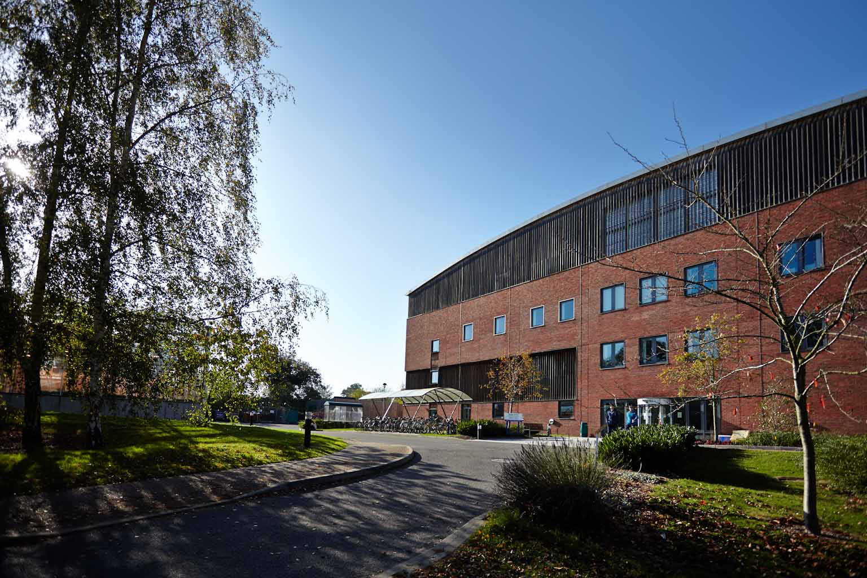
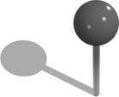





Pilar
/pilarcormo
@PilarCorMo

Slide 2

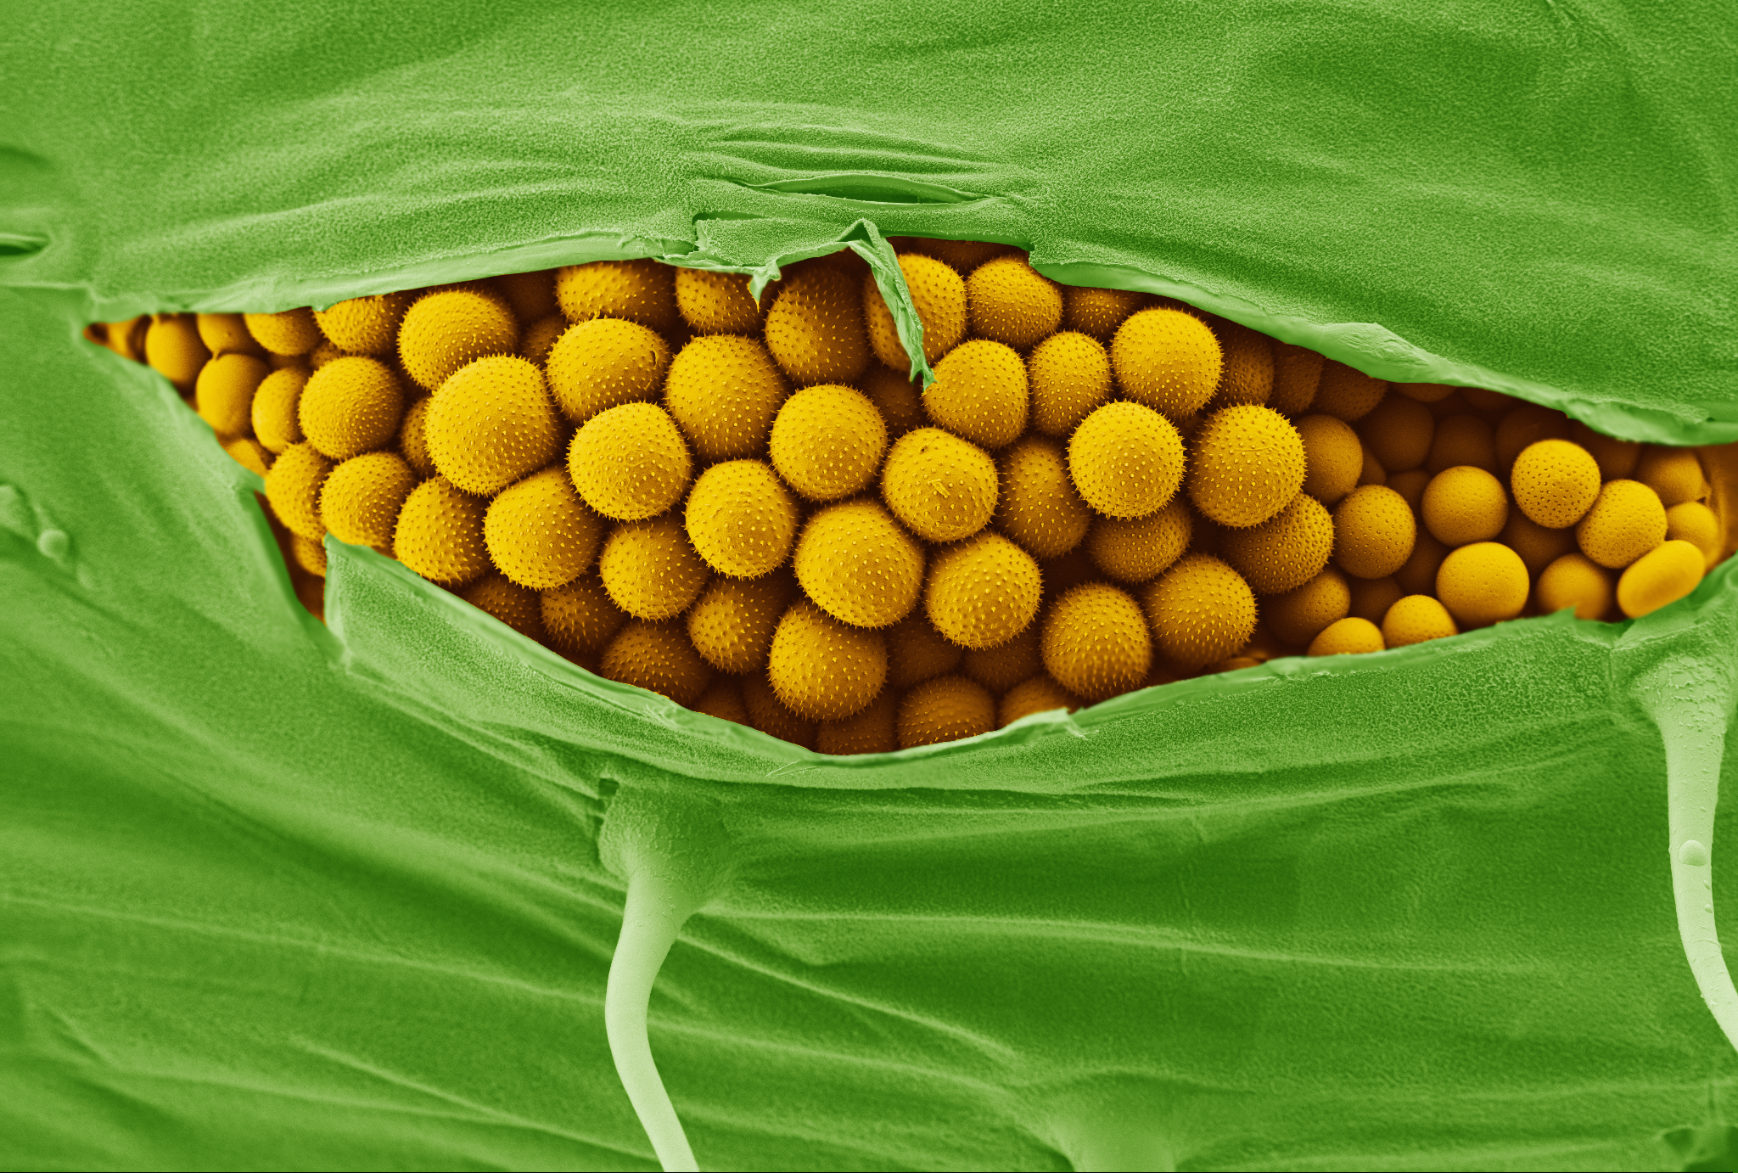
Wheat yellow (stripe) rust
Image: Kim Findlay (JIC)
Puccinia striiformis f.sp. tritici
Notes:
Puccinia striiformis f. sp tritici (PST), is an historical and continuing threat to wheat production worldwide, reducing yields by up to 50% in untreated crops.
Here we see the shear power of this pathogen with spores ripping their way through the leaf surface.
In the last decade, new PST races have emerged that are capable of adapting to warmer temperatures, have expanded virulence profiles, and are more aggressive than previously characterized races.
More recently, PST has re-emerged as a major constraint on UK agriculture as races arising in Europe have overcome many of the major resistance genes in European germplasm. For instance, in 2011 a PST race group collectively called “Warrior” emerged as a serious threat to wheat production.
Yellow Rust spores can be seen bursting out of a wheat leaf from the inside, tearing their way through the epidermis.
SEM photography by Kim Findlay, John Innes Centre
08/21 2008 (solstice) overcame important wheat varieties robigus-derived (solstice and oakley)
Warrior 2011 overcame additional set of resistances inclu. Alchemy, Warrior and Claire
With Claire and Robigous ubiquitous use in UK pedigree of wheat varieties extremely narrow genetic range for resistance
This year up to 75% acreage susceptible to warrior race.

Slide 3
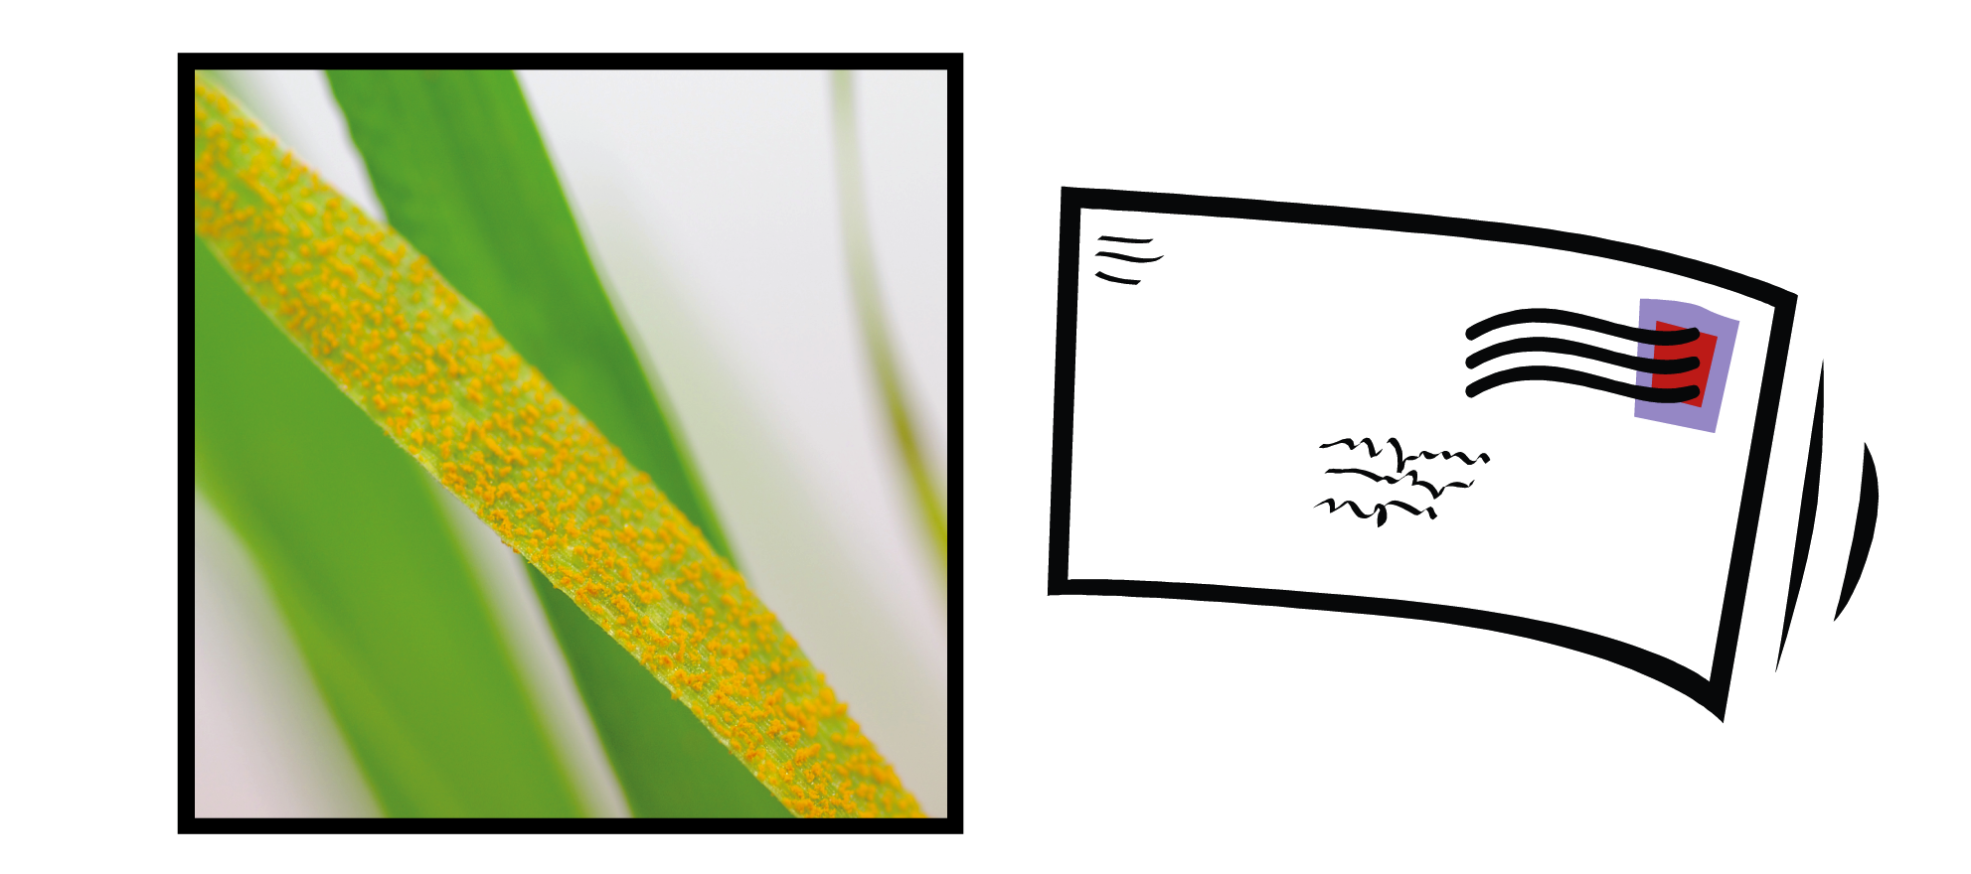
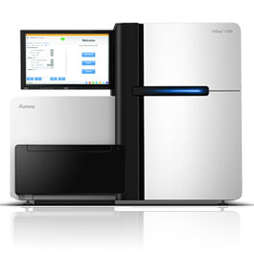
Field Pathogenomics
Receive sample from the field
RNA-seq
Notes:
Puccinia striiformis f. sp tritici (PST), is an historical and continuing threat to wheat production worldwide, reducing yields by up to 50% in untreated crops.
Here we see the shear power of this pathogen with spores ripping their way through the leaf surface.
In the last decade, new PST races have emerged that are capable of adapting to warmer temperatures, have expanded virulence profiles, and are more aggressive than previously characterized races.

Slide 4

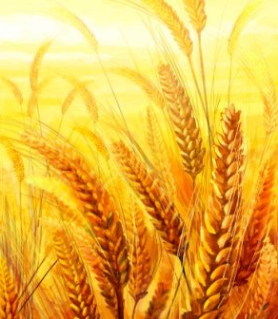
Field Pathogenomics
Receive sample from the field
RNA-seq
Alignment to reference genome
Pathogen
Wheat
Notes:
Puccinia striiformis f. sp tritici (PST), is an historical and continuing threat to wheat production worldwide, reducing yields by up to 50% in untreated crops.
Here we see the shear power of this pathogen with spores ripping their way through the leaf surface.
In the last decade, new PST races have emerged that are capable of adapting to warmer temperatures, have expanded virulence profiles, and are more aggressive than previously characterized races.

Slide 5
Field Pathogenomics
Receive sample from the field
RNA-seq
Alignment to reference genome
Pathogen
Wheat
Study pathogen evolution
Identify new races
Notes:
Puccinia striiformis f. sp tritici (PST), is an historical and continuing threat to wheat production worldwide, reducing yields by up to 50% in untreated crops.
Here we see the shear power of this pathogen with spores ripping their way through the leaf surface.
In the last decade, new PST races have emerged that are capable of adapting to warmer temperatures, have expanded virulence profiles, and are more aggressive than previously characterized races.

Slide 6
Field Pathogenomics
Receive sample from the field
RNA-seq
Alignment to reference genome
Pathogen
Wheat
Study pathogen evolution
Identify new races
Identify resistance genes
Determine wheat variety
Notes:
Puccinia striiformis f. sp tritici (PST), is an historical and continuing threat to wheat production worldwide, reducing yields by up to 50% in untreated crops.
Here we see the shear power of this pathogen with spores ripping their way through the leaf surface.
In the last decade, new PST races have emerged that are capable of adapting to warmer temperatures, have expanded virulence profiles, and are more aggressive than previously characterized races.

Slide 7
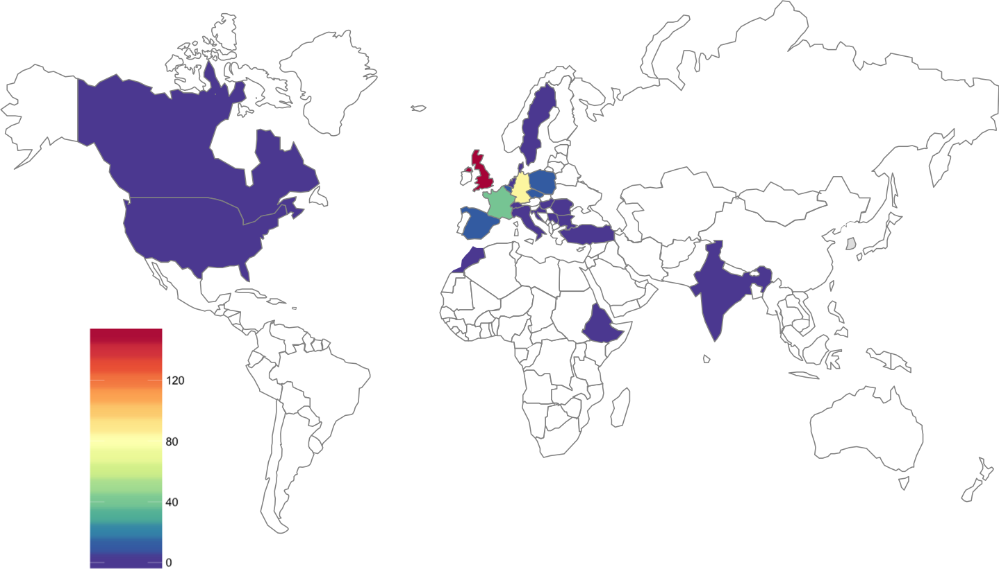
RNA-seq data
> 400 samples

